Slide 1
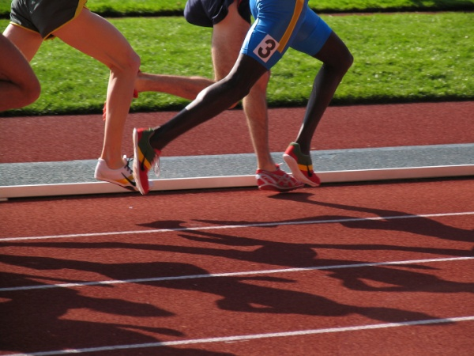
Training techniques and Common Injuries for the Runner
Michael Evangelist, MS, PT
Partner/ Clinical Director
JAG Physical Therapy - Warren

Slide 2
Objectives
Review common injuries in runners
Discuss treatment strategies
Return to sport activities for runners
Preventative exercise for runners

Slide 3
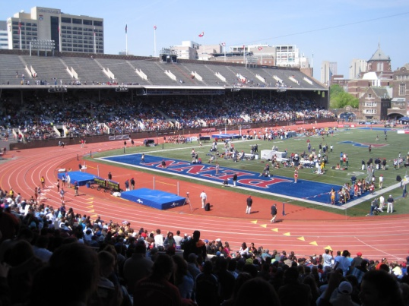
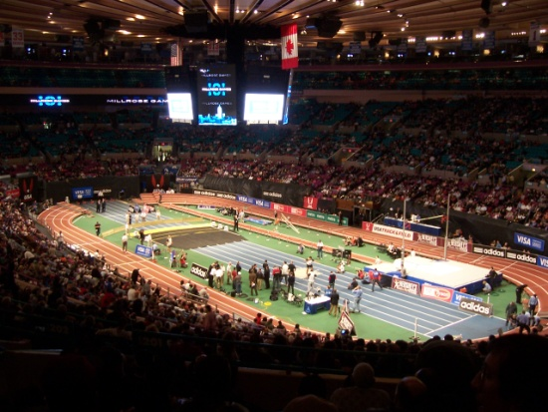
Popularity of Track and Field
Cross Country/Track and Field is the #1 participatory sport in American Junior High and High Schools
In 2012, over 10 million Americans reported running 100 times or more in a year
Cross Country/Track and Field has seen a steady increase in popularity since the 1970’s in America.

Slide 4
Prevalence of Injuries in Track and Field
Runners have the highest incidence of injury behind football and soccer in high school athletics
Most commonly reported injuries
Shin Splints
Patellofemoral Pain Syndrome
ITB Syndrome
Stress Fracture
Tendonitis (Achilles, Patella)
Muscle Strains (hamstring, calf)
Most of these Injuries are OVERUSE injuries

Slide 5
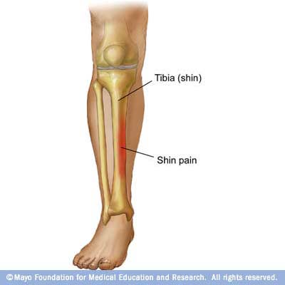
Shin Splints
Shin Splints (MTSS) is an injury in which the anterior/posterior tibialis muscle is irritated at its origin on the medial tibia
Pain is usually caused due to excessive force on the lower extremity
Running downhill
Repetitive sprints/plyometrics
Running on too hard a surface

Slide 6
Shin Splints Treatment
Best treatment is rest and ice
Ice massage at area of inflammation post run
Orthotics to provide proper cushioning
Strengthening of surrounding muscles
Calf muscles
Posterior tibialis
Peroneals
Foot intrinsics
Barefoot warm ups
Return to running on soft surfaces first

Slide 7
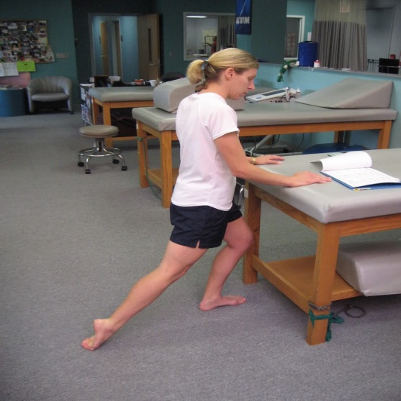
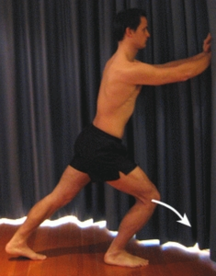
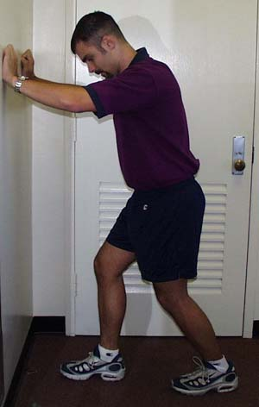
Shin Splints Prevention
Prevention: Duck walk drills prior to workouts
4 Way ankle strengthening
Stretching of calf/anterior tibialis
“Quiet” running drills
Running without hearing your feet slap the ground
Improves mechanics, decreases stress on lower leg

Slide 8
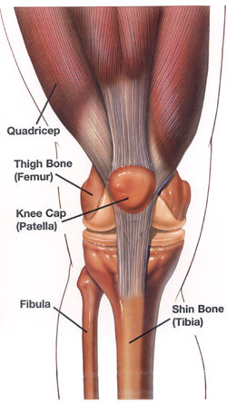
Patellofemoral Pain Syndrome
Pain around the knee cap which is caused by poor tracking of patella.
Typically due to imbalance of muscles or poor Q angle
Females > Males
Symptoms include
Pain with prolonged bending of knee
Difficulty descending stairs
Pain after running/sport activity

Slide 9
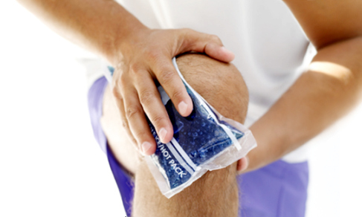
PFPS Treatment
Focus on correcting strength imbalances
VMO
Gluteus Medius
Deep Hip Rotators
ICE
Bracing if needed

Slide 10
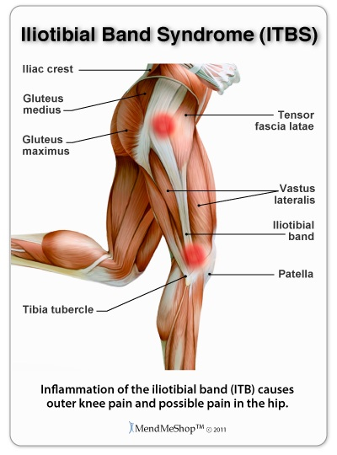
Iliotibial Band Syndrome
What is it?
Inflammation of the IT Band (band of fascia on the outside of the leg)
Accounts for 12% of all running injuries
Risk Factors:
Downhill running
Over-pronation
Weak hip abductors/rotators

Slide 11
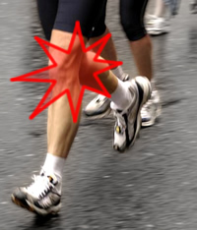
Iliotibial Band Syndrome
Rehab Tips
Decrease mileage until pain subsides
Avoid downhill running
Foam roll IT Band
Strengthen hip abductors/rotators
Shorten your stride

Slide 12
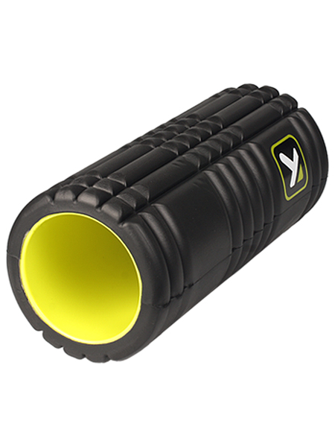
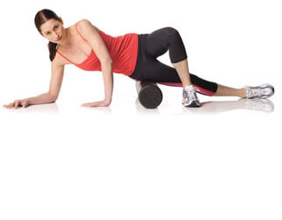
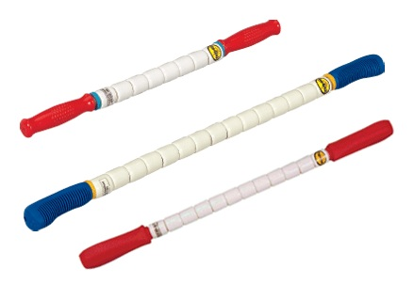
PFPS and ITBS Treatments
Foam Roll and The Stick to increase ITB flexibility

Slide 13
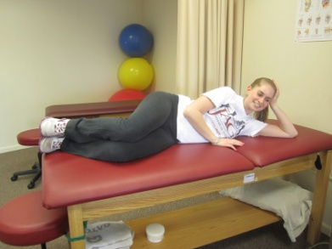
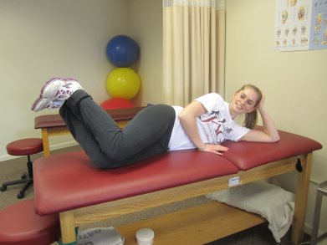
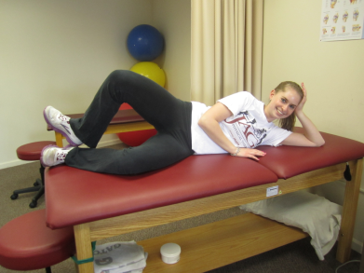
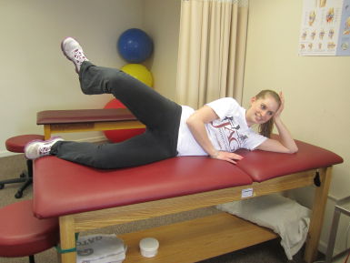
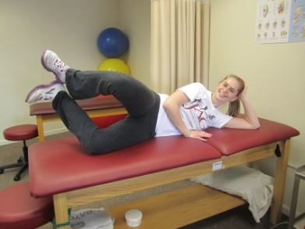
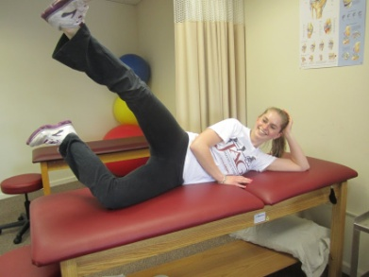
PFPS and ITBS Treatments
Gluteus Medius Strengthening Exercises
Clam Shell Series

Slide 14
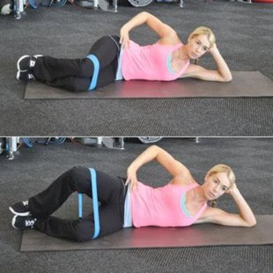
PFPS and ITBS Treatments
Gluteus Medius Strengthening Exercises

Slide 15
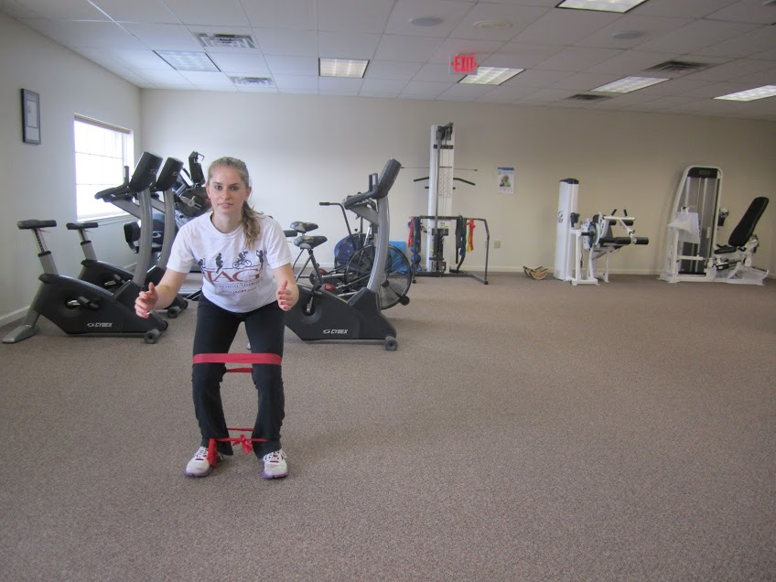
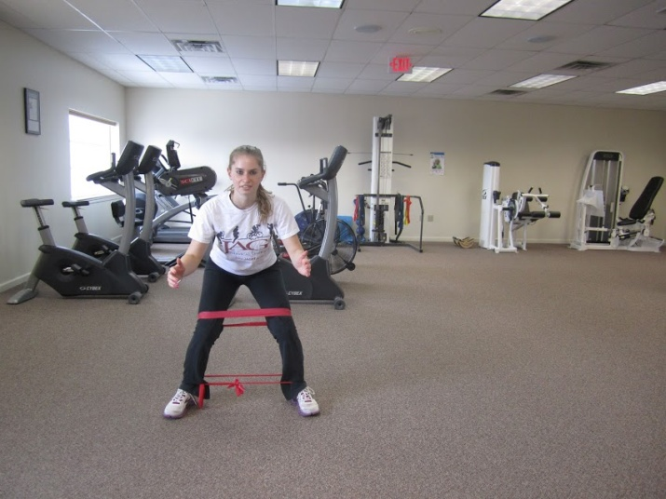
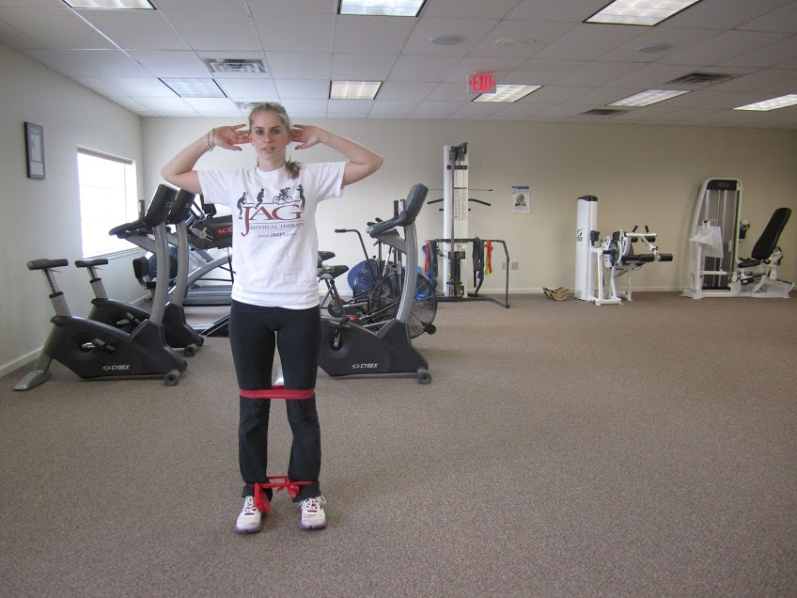
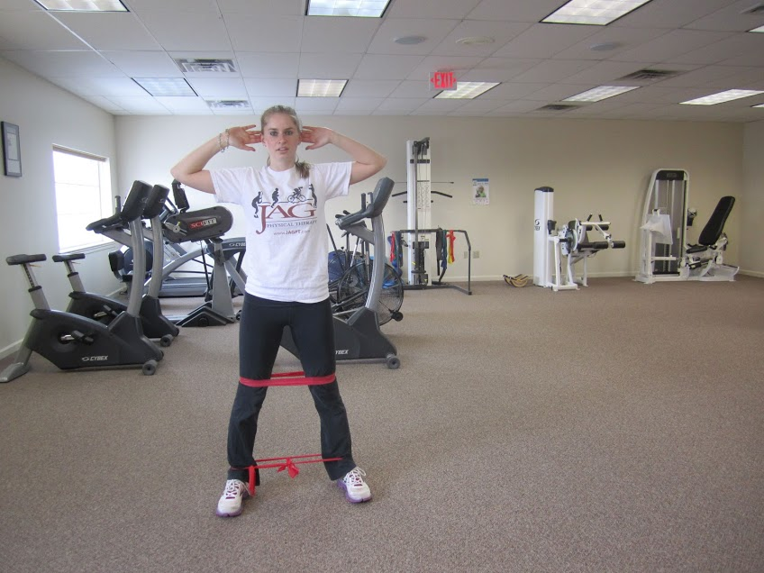
PFPS and ITBS Treatments
Gluteus Medius Strengthening Exercises
Lateral Walks

Slide 16
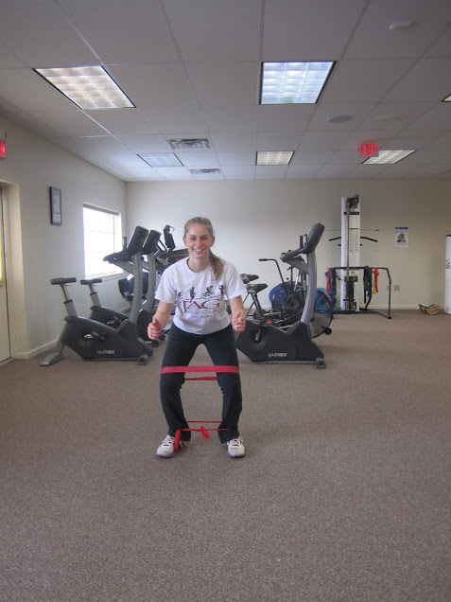
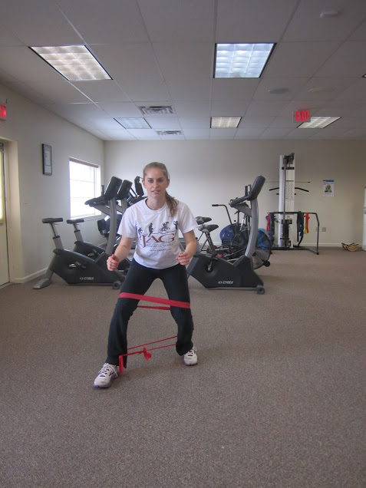
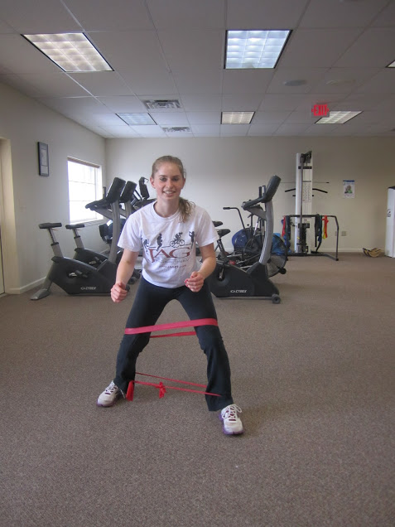
PFPS and ITBS Treatments
Monster Walks

Slide 17
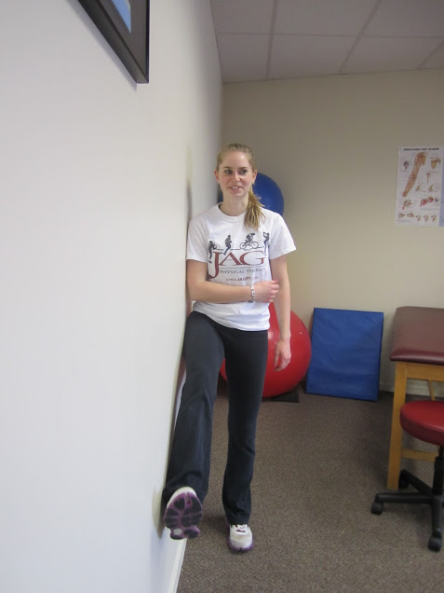
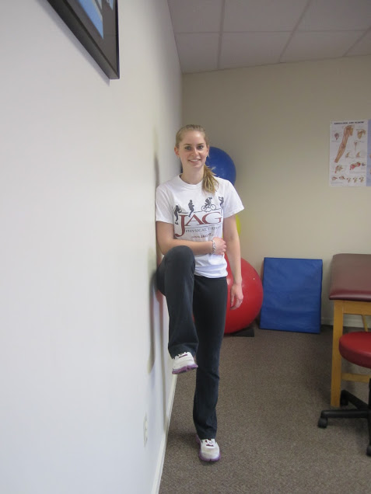
PFPS and ITBS Treatments
Gluteus Strengthening Exercises
Wall Drills

Slide 18
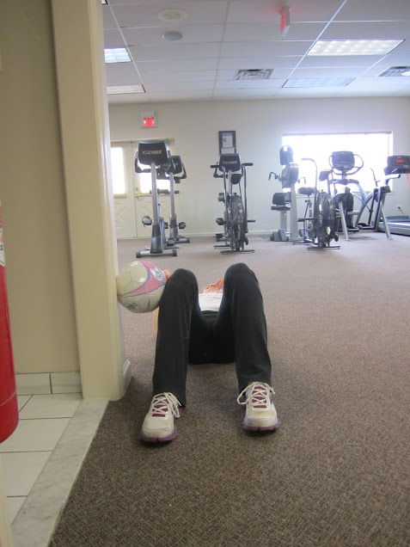
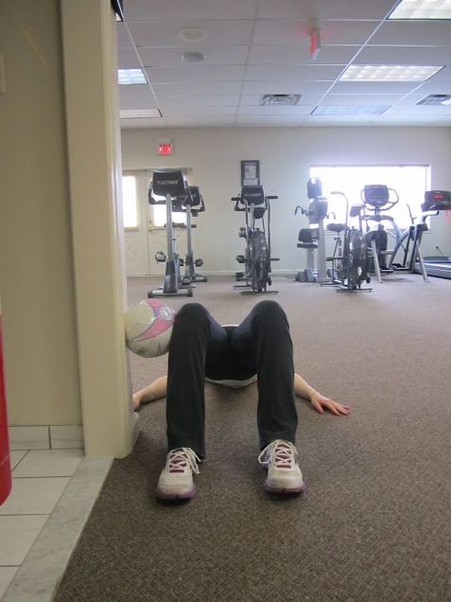
PFPS and ITBS Treatments
Bridges

Slide 19
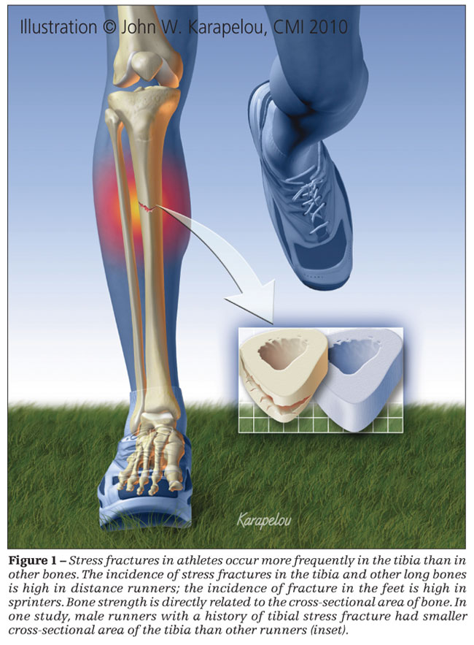
Stress Fracture
What is it?
Cumulative strain on the bone
Most commonly in the tibia (shin), metatarsals (foot), or calcaneus (heel)
Risk Factors:
Overtraining
More common in women
Female Athlete Triad
Runners with nutritional deficits

Slide 20
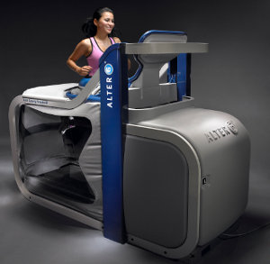
Stress Fracture
Rehab Tips
Do NOT run through a stress fracture
Expect to not run for 8-16 weeks or as directed by your doctor
Strength train to improve bone density health
Eat a well balanced diet and plan to get enough calcium and vitamin D
Consider shortening your stride if you have re-current stress fractures
Alter-G treadmill or pool running
Notes:
a December 2009 study reports that runners who shorten their stride by 10 percent could reduce risk of tibial stress fracture by three to six percent. The basic idea: Overstriding is a common mistake that can lead to decreased efficiency and increased injury risk. If you shorten your stride, you'll land "softer" with each footfall, incurring lower impact forces. "A shorter stride will usually lower the impact force, which should reduce injuries," says biomechanist Alan Hreljac, Ph.D., a retired researcher from California State University-Sacramento.
Olympics Injuries
Your Sports Injury Questions
Become a member
Home
Conditions & Symptoms
Free Training Tips
Treatments
Sports
Body Parts
Forum
Shop
Site Map
Affiliate
SIB Recommends
Subscribers Area
Sports
Athletics Injuries
Baseball Injuries
Basketball Injuries
Boxing Injuries
Cricket Injuries
Cycling Injuries
Field Hockey Injuries
Football Injuries
Golf Injuries
Ice Hockey Injuries
Martial Arts Injuries
Mountain Biking Injuries
Rowing Injuries
Rugby Injuries
Running Injuries
Skiing Injuries
Snowboarding Injuries
Soccer Injuries
Swimming Injuries
Tennis Injuries
Triathlon Injuries
Weight Training Injuries
Wrestling Injuries
...all sports
Body
Ankle Injuries
Anterior Cruciate Ligament
Back Injuries
Elbow Injuries
Foot Injuries
Groin Injuries
Hamstring Injuries
Hand Injuries
Head Injuries
Hip Injuries
Iliotibial Band Injuries
Knee Injuries
Leg Injuries
Musculoskeletal injuries
Neck Injuries
Shoulder Injuries
Thoracic Injuries
Wrist Injuries
...all body parts
Conditions & Symptoms
Achilles tendinitis
Back Spasms
Groin Strain
Knee Pain
Medial Tibial Stress Syndrome
Metatarsalgia
Overtraining
Plantar Fasciitis
Rhabdomyolysis
Runners Knee
Shin Splints
Tennis Elbow
...all conditions & symptoms
Treatments
Coaching
Core Stability
Core Training
Flexibility
Hydration
Injury Prevention
Nutrition
Plyometrics
Psychology
Sports Medicine
Stretching
Supplements
...all treatments
User login
Username: *
Password: *
Create new account
Request new password
RSS feed
Email us
About us
FAQ
shin splints treatment, shin splints exercise, preventing shin splints, care of shin splints
Shin splints treatment - exercise to strengthen the lower legs, prevent, repair and care for shin splints problems.
Register today to receive valuable, injury prevention and treatment advice every week.
Email: >>
When you decided to get really serious about your training earlier this year, everything went smoothly for several weeks, but one day you felt a dull ache on the inside, lower portion of your shin as you began your workout. The discomfort went away once you had warmed up, so you weren't overly concerned.
Unfortunately, the pain returned on the following day - and lasted for a longer portion of your workout. As the days went by, pain was present for the whole training session, as well as your cool-down - and even hung around during your regular daily activities. When you used your fingers to probe the area near the back, inside edge of the lower part of your tibia (the main bone in the lower part of the leg), you felt tenderness but no major swelling, and the pain seemed to centre in the tissues (muscles and tendons) near the tibia, not the tibia itself.
================================================= More information on Shin Splints: All of our articles on shin splints Medial tibial stress syndrome - Two quick fixes for shin splints
Shin splints: The runner's disease
Q&A - What can I do to heal Shin Splints?
Q&A Shin splints or stress fracture?
Got a question about shin splints? Ask other sports professionals here.
=================================================
What was wrong?
Of course, you had developed a classic case of 'shin splints', an injury which is more accurately called medial tibial stress syndrome (MTSS). Many experts believe that shin splints (MTSS) is the most common injury among athletes whose sports involve extensive amounts of running (e.g., runners, soccer players, rugby players and other participants in field sports); indeed, research shows that up to one in five injured runners are 'on the shelf' because of shin splints ('Relieving Painful Shin Splints,' The Physician and Sportsmedicine, vol. 20(12), pp. 105-113, 1992). And it's an especially troubling injury, because it can stop quality training in its tracks and also tends to recur, defying conventional treatments. The actual site of injury in the shin area can be muscle, tendon, bone - or the connective-tissue wrappings which surround your muscles and bones.
Some exercise scientists contend that MTSS is almost inevitable, since each shin absorbs a force equal to two to three times body weight with every footfall during running - about 700 times per shin per mile, mile after mile. The cumulative effect of this repetitive stress on the muscles and connective tissues in the shin area is believed to be the origin of MTSS. For that reason, MTSS is often called an 'overuse' injury, although as you'll see in a minute, the real problem is not so much overuse as it is a lack of preparation for use. Specifically, shin splints occurs because the ankle dorsiflexors - the shin muscles which in effect pull the top surface of the foot toward the shin and also (as part of their eccentric functioning) keep the foot from being pulled away from the shin too rapidly - are not functioning as well as they should.
The key role of these ankle dorsiflexors during running is in fact to control and limit plantar flexion - the movement of the foot away from the shin. During the very earliest part of the footstrike portion of the gait cycle - right after the foot makes contact with the ground, there's a tendency for the foot to slap hard against terra firma. In a 'heel-striker,' for example (a runner who first makes contact with the ground with his heel), forward momentum tries to slap the rest of the bottom of the foot against the ground very quickly and forcefully, an uncoordinated and energy-wasting action which is resisted by eccentric contractions of the dorsiflexors.
The sound of slapping feet
If a runner has weak ankle dorsiflexors, you can often 'hear him coming a mile away', because his feet actually make slapping sounds against the pavement (of course, such a runner will be at high risk for MTSS, because the rapid downward movement of the foot will tear at and overstress the dorsiflexors). In contrast, the runner with strong, functional dorsiflexors will seem to pad softly along, even if he is running on rock-solid concrete. Watch some of the elite Kenyans running, for example, and compare their foot-to-ground patterns with those of elite Brits or Americans or the average recreational athlete. The Kenyans build up tremendous dorsiflexor strength and functionality because they spend their initial years of life running and walking endless miles while barefooted, instead of moving around with their feet clamped into fluffy midsoles which shield the feet from hard work - or sitting around with feet propped up on a soft hassock. As a result, the Kenyans waste very little energy during the stance phase of the gait cycle - and seldom hobble off the track or roads with a shin injury.
In addition to controlling plantar flexion, the dorsiflexors must also deal with side to side motions of the foot and ankle during running - as well as the rotational motions which are a natural part of the gait cycle. Any tendency of the foot to pronate must be controlled by the shin muscles. Any tendency of the foot to supinate must also be reined in by the dorsiflexors. If there is relentless, stressful motion in any direction, the shin muscles can be damaged. That's why many of the shin splints exercise routines which supposedly prevent shin splints don't work so well; they often emphasize only front-and-back motions, rather than the side-to-side and rotational activities which are routine aspects of the biomechanics of running. The bottom line is that if you want to prevent shin splints, you can't merely develop general strength in your dorsiflexors - or strength which exhibits itself in only one plane of motion: your dorsiflexors must actually be stronger while you are running. More on that in a moment! That's why the classical mode of treatment for shin splints - RECEIPT (rest, elevation, compression, easy stretching of the muscles, icing, and possibly taping) - works fairly well at relieving symptoms but does a very poor job of keeping the injury from recurring. Only by improving the functional strength of the dorsiflexors and the strength and coordination of the entire ankle area can one be confident that MTSS will be held at bay. If your dorsiflexors are strong enough to handle your total training load, and they aren't yanked around too badly by poorly controlled ankle movements, your training year should be un-marked by the pain and disruption of shin splints.
Try these MTSS-preventing exercises
So what should you actually do to lower your risk of MTSS? Well, simply utilize our shin-splint-preventing exercises, outlined below:
1. Wall Shin Raises. Simply stand with your back to a wall, with your heels about the length of your feet away from the wall. Then, lean back until your buttocks and shoulders rest against the wall. Dorsiflex both ankles simultaneously, while your heels remain in contact with the ground. Bring your toes as far toward your shins as you can, and then lower your feet back toward the ground, but do not allow your forefeet to contact the ground before beginning the next repeat. Simply lower them until they are close to the ground, and then begin another repetition. Complete about 12 to 15 reps.
Once you have finished the reps, maintain your basic position with your back against the wall, dorsiflex your ankles to close to their fullest extent, and then quickly dorsiflex and plantar flex your ankles 15 times over a very small range of motion (smaller than the nearly full range you use for the basic reps; the emphasis here is on quickness). These short, quick ankle movements are called pulses.
As you gain strength over time, make the wall shin raises progressively more difficult by advancing from one set of 15 reps to two and then three sets of 15 (for the basic raises and the pulses). It's OK to walk around for 15 to 30 seconds between sets.
Now the single-leg raise
Once you can quite comfortably complete 3 x 15 of the double-leg raises (both basic and quick), progress to the single-leg wall shin raise. The basic position for this exercise is as before, except that you begin with only one foot in contact with the ground; the other foot rests lightly on the wall behind you. Now, full body weight is on one foot - as it is during running - as you carry out the overall routine, and the exercises are considerably more difficult. Begin with 12 to 15 reps per foot (both for the basic exercise and pulses), and progress to 3 x 15 (basic and pulse) on each foot as your strength increases. There's no need to rest between sets; simply carry out 15 reps on one foot plus the pulses, shift over to the other for 15 repetitions and pulses, return to the original foot, and so on until you have completed three sets with each foot.
2. Heel Step-Downs These are simple but devastatingly effective exercises for preventing MTSS. Begin with a natural, erect body position, with your feet about shoulder-width apart, and then step forward with one foot. The length of the step should be moderate - as though you were walking in your normal manner. When your heel makes contact with the ground, stop the foot from fully plantar flexing, ie, use your shin muscles to keep the sole of the foot from making contact with the ground. After heel contact, the ball of your foot should descend no more than an inch toward the floor or ground; your foot is held in check by the eccentric contractions of your dorsiflexors (shin muscles). Return your foot to the starting position (back by the other foot), and repeat this basic stepping action a total of 15 times. Then, shift over to the other foot and complete 15 steps. As with the wall shin raises, progress to three sets of 15 reps over time.
Now with longer steps
Once you have mastered the basic heel step-downs, perform the same exercise - but with dramatically longer steps. Using lengthier steps will increase the accelerating forces placed on the dorsiflexors and force them to work more forcefully and quickly, as they must do during running. Start with one set of 15 reps of long steps per foot, and progress to 3 x 15 on each foot over time.
Finally, you will be ready to carry out the heel step-downs from a high step, which will increase the forces on your shin muscles to the greatest extent - and build the greatest amount of strength. Use a bench or exercise platform which is about four inches off the ground to carry out your stepping. Aside from beginning each step from a bench, your movements are the same as they are in the basic step-downs; the idea is to land on the heel of the forward foot and then to use the shin muscles to prevent the sole of the foot from making contact with the ground (again, don't let the ball of the foot move downward by more than an inch). The actual length of the step is moderate at first (you can progress to long steps later). As before, begin with 15 reps per foot, and progress to three sets of 15 reps as you gain strength and coordination.
Both the wall shin raises and heel step-downs can be carried out three to four times a week, along with your other strength-building exercises (you can complete them more often if you've had lots of problems with MTSS in the past; don't do them to the point of pain, however).
================================================= More information on Shin Splints: All of our articles on shin splints Medial tibial stress syndrome - Two quick fixes for shin splints
Shin splints: The runner's disease
Q&A - What can I do to heal Shin Splints?
Q&A Shin splints or stress fracture?
Got a question about shin splints? Ask other sports professionals here.
=================================================
Warm up to stronger shins
The following portion of the shin-splint-preventing routine can be completed during the warm-ups preceding your regular workouts. The prescribed exercises develop shin strength and resiliency, as well as overall ankle coordination, and thus are great antidotes for your ankles' desires to begin hurting during strenuous training. It's also a good idea to include the exercises in your warm-ups; doing so transforms the warm-up from humdrum routine into an important strength and coordination session. Here's what to do:
1. Walk on your toes with your toes pointed straight ahead for about 20 metres, getting as high up on your toes as you possibly can. Your legs should be relatively straight as you do this, and you should - at least initially - take fairly small steps.
Then, cover 20 metres high up on your toes, but with your toes pointed outward. Your legs should rotate outward from the hips when you perform this movement; don't merely turn each foot at the ankle - the whole leg is involved.
Finally, walk 20 metres high on your toes, but with your toes pointed inward. As you do so, rotate the entire leg in from the hip, not just the ankle. Repeat each of these activities (toes pointed ahead, toes pointed out, toes pointed in) at least one more time before going on to the second exercise.
2. Walk on your heels with your toes pointed straight ahead for about 20 metres, getting as high up on your heels as you possibly can. Your legs should be relatively straight as you do this, and you should - at least initially - take fairly small steps.
Then, simply proceed as you did with the toe walks, walking 20 metres on your heels with toes pointed outward and then 20 metres on heels with toes pointed inward. Repeat each of the heel walks (toes straight ahead, toes pointed outward, toes in) at least one more time.
As the toe and heel walks become easy for you, graduate to doing the three variations of each exercise while jogging lightly, instead of walking! At least at first, you should make certain you are on a padded or grassy surface when you jog on toes and heels.
3. Skip for 20 metres, landing in the mid-foot area with each contact with the ground, and with toes pointed straight ahead. Then, do the same, but with toes pointed out for 20 metres, and then with toes pointed in for 20 metres. Repeat the sequence at least one more time.
4. Then, get well up on your toes and skip for 20 metres with toes straight ahead, pointed out, and pointed in.
Now skip on your heels
Once the skipping exercises are comfortable, try some light skipping on your heels. Gradually build up your ability to heel-skip with toes straight ahead, pointed out, and pointed in for 20 metres at a time. Heel skipping is a great way to build dorsiflexor strength, but carry it out only on a padded or grassy surface to avoid impact injury to your heels.
[adsense:336x280:1772170819]
5. Once you've completed your walking, jogging, and skipping routines, it's time for rhythm bounding. This isn't the kind of bounding you're probably envisioning - we don't mean progressing forward with extra-long strides, at least not at first. Rather, you should jog along with very springy, short steps, landing on the mid-foot area with each contact and springing upward after impact. As you rhythm bound, your ankles should act like coiled springs, compressing slightly as you make your mid-foot landing and then recoiling quickly - causing you to bound upward and forward. Move along for 20 metres or so with these quick, little, spring-like strides, alternating right and left feet as you would during running. After 10 to 20 metres of regular jogging, rhythm bound for 20 more metres, alternating three consecutive spring-like contacts with the right foot with three with the left. After 10 to 20 more metres of regular jogging, close the set by bounding along for the full 20 metres on your right foot only, followed by 20 metres on the left (making certain that you land on the mid-foot area with each ground contact and that your ankle area, not your knee or hip, is doing most of the work). Make sure (at least at first) that all of this is done on a padded surface or soft grass. As you become stronger and more skilled, you can increase the length and amplitude (vertical height) of each bound and include additional sets of bounds (work your way up to four sets).
6. Complete some 'dorsiflexion bounces'. To do these, simply begin jumping vertically and repetitively at close to maximal height, landing in the mid-foot area with both feet and then springing upward quickly after each contact with the ground. The interesting part of this exercise is that you should dorsiflex your ankles - pulling the tops of your feet toward your shins - on each ascent, before plummeting back toward earth and plantar flexing your ankles just before making contact with the ground. Do 10 dorsiflexion bounces, rest for 10 seconds or so, and then repeat. Over time, you can add additional sets and increase the number of reps to 30. When you are really strong and skilled, perform this exercise on just one foot at a time, but only on a low-impact surface.
7. Finally, carry out rhythm bouncing. Rhythm bouncing is actually just jumping around, but what jumping! You should start with 10 jumps in place, moderately fast, with medium height, and with maximal motion at the ankles - but little flexion and extension at the knees and hips (over time, you can work up to 30 jumps). Then, after resting for a few seconds, change the amplitude (height) of your jumps to less than an inch, and complete 20 jumps as fast as you possibly can (pretend that your feet are hitting a hot stove - so that you must minimize your impact time with the ground). Again, almost all of the action should take place at your ankles, not at your knees and hips. As you become more skilled, work up to 40 quicksilver jumps.
After resting for a few seconds, complete five 'high-impact' jumps, increasing the amplitude (vertical height) of your jumping as much as possible. Over time, progress to 30 of these maxi-jumps.
So far, all of the rhythm bounces have been carried out in place, so make things interesting by jumping forward and then backward as quickly as possible. After you have made 20 'contacts' (each time your feet strike the ground is one contact), rest for a few seconds and then jump from side to side for 20 contacts. Rest again, and then jump in a direction which is about 45 degrees from straight ahead, alternating directions (first towards the right, then towards the left) for 20 contacts as you move ahead in a zig-zag manner. Remember to use your ankle muscles to propel you, not the big muscles at the knees and hips.
As you gain skill and strength, you can increase the number of sets of each type of rhythm bouncing from one to three, and then - the fun part - carry out each type of bouncing on one foot only. Moving in different directions as you bounce increases the ability of your shin muscles to handle all of the forces created during running - the side-to-side and rotational stresses, in addition to the less-overlooked front and back forces.
Other considerations
Of course, carrying out these exercises doesn't mean that your risk of MTSS is zero. If you suddenly change your weekly volume of running from 25 to 75 miles because you've been bitten by the marathon bug, for example, something will have to give, and it might well be your shin muscles and tendons. So, be certain to avoid dramatic changes in the frequency, volume, or intensity of your training; always gradually progress to more difficult levels of work.
Sports-medicine experts often recommend stretching the ankle area by slowly moving the ankle to 'each' end of its range of motion in the straight-back and straight-ahead plane, eg, to the fully dorsiflexed and then completely plantar-flexed positions, holding each position for anywhere from five to 60 seconds. The problem with that, of course, is that you are only stretching your muscles in one plane of motion and thus not adequately mimicking the stretching which takes place during running. At the very least, in addition to carrying out the plantar-flexed and dorsiflexed stretches, you should also stretch each ankle by fully rotating it outward and inward - and by plantar flexing and dorsiflexing the ankle while the foot is pointed both outward and inward to various degrees - not just straight ahead.
The experts also recommend strengthening the ankle area by adding resistance to the above stretching movements with the use of surgical tubing or elastic bands. That is indeed a way to increase general strength of the ankle, and it will certainly make you stronger when you carry out surgical-tubing exercises in the future. The problem, of course, is that you run with your feet on the ground - not poised in the air in the clutches of elastic bands. So, to fully prepare your ankles and shins for the rigours of running, you're better off focussing on the specific exercises we are recommending.
Does stretching actually help to prevent MTSS? No scientific evidence indicates that it does, but the idea that stretching might be protective is a logical one (overly taut muscles seem more likely to be damaged by pulling forces, compared to relaxed fibres). Don't stretch your ankle area until after your muscles are warm, however; a good time would be after a warm-up and/or at the end of your training session.
Other lower leg injuries
Of course, all problems in the lower part of the leg are not necessarily examples of MTSS. In particular, two conditions - compartment syndromes and tibial stress fractures - can sometimes be confused with shin splints.
Compartment syndromes owe their name and origin to the fact that the leg muscles are not simply loose straps which run from bone to bone. In reality, the muscles are often grouped together into little sections of the leg which are enclosed by a tough wrapper of connective tissue. Such an arrangement of muscles tucked into a wrapper is called a 'compartment'.
During the act of running, excess fluid can build up within one of these compartments, putting pressure on muscle fibres, nerve cells, and blood vessels - and also causing a great deal of pain. Frequently, the pain will be so severe that a runner must curtail a workout or come to a standstill during a race. And the pain will usually be accompanied by the two telltale symptoms of a compartment syndrome - numbness and weakness.
Numbness occurs because the excess pressure within a compartment hampers the activity of sensory nerves carrying messages to the brain. As a result, the runner with compartment syndrome may lose feeling in the 'web' of the foot - between the first and second toes, or the insensitivity may extend up the foot toward the ankle. Weakness is experienced because motor nerves carrying impulses towards the muscles are also damaged by the high pressures within the compartment. If a compartment in the front of the leg is involved, a runner may have trouble dorsiflexing the ankle, and the foot may seem to flop loosely. In a posterior-compartment problem involving muscles in the back of the leg, there is often weakness when an individual tries to 'toe off'.
If you truly have a compartment syndrome, you will usually observe swelling in your lower leg which tends to subside when your leg is elevated. A doctor can tell for sure if you have this troubling problem by placing a catheter into one of your compartments and measuring pressure before, during, and after running (you will usually have to run long enough to produce pain during this test).
What about stress fractures?
Stress fractures are small breakdowns in bony tissue, and tibial stress fractures, which are sometimes confused with MTSS, are the most common of all stress fractures in athletes, accounting for about 50 per cent of the total. In addition to producing a lot of pain, stress fractures can actually progress into dislocation fractures, in which two parts of the bone actually separate. Stress fractures also may be 'warning signals' for an underlying nutritional or hormonal problem.
Unfortunately, traditional X-rays often fail to detect stress fractures, so a more costly procedure called a bone scan must frequently be performed to confirm the diagnosis. In a bone scan, radioactive material is actually injected into the blood. Bony tissue which is remodelling and rebuilding itself at the site of a stress fracture will accumulate more of this infused radioisotope, causing the affected bony area to show up as a dark splotch on a 'scintigram'. While it's often said that stress fractures take two to three months to heal, up to six months may be required to restore the bone to normal and remove most traces of pain, and a few athletes need more than a year to fully recover.
Sometimes called 'crescendo pain,' the agony associated with stress fractures tends to build up steadily during running, beginning as an annoying irritation and becoming a throbbing torment as an individual continues to run. There is usually little of the numbness, weakness, and swelling associated with compartment syndrome, and pain is usually not present when an athlete is at rest. Often, the bone will hurt when it is tapped near the damaged area, and occasionally a hard nodule will appear on the surface of the bone at the trouble site.
If you're diagnosed with a stress fracture, you should be sure to have a nutritional analysis carried out (your problem might be the result of inadequate calcium intake or poor calcium absorption).

Slide 21
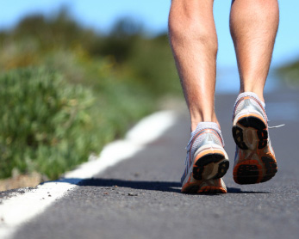
Tendonitis
Overuse injury which causes inflammation around the tendon of a muscle
Most commonly seen in patella tendon and Achilles tendon in track
Treat with eccentric strengthening activity to decrease
inflammation at tendon

Slide 22
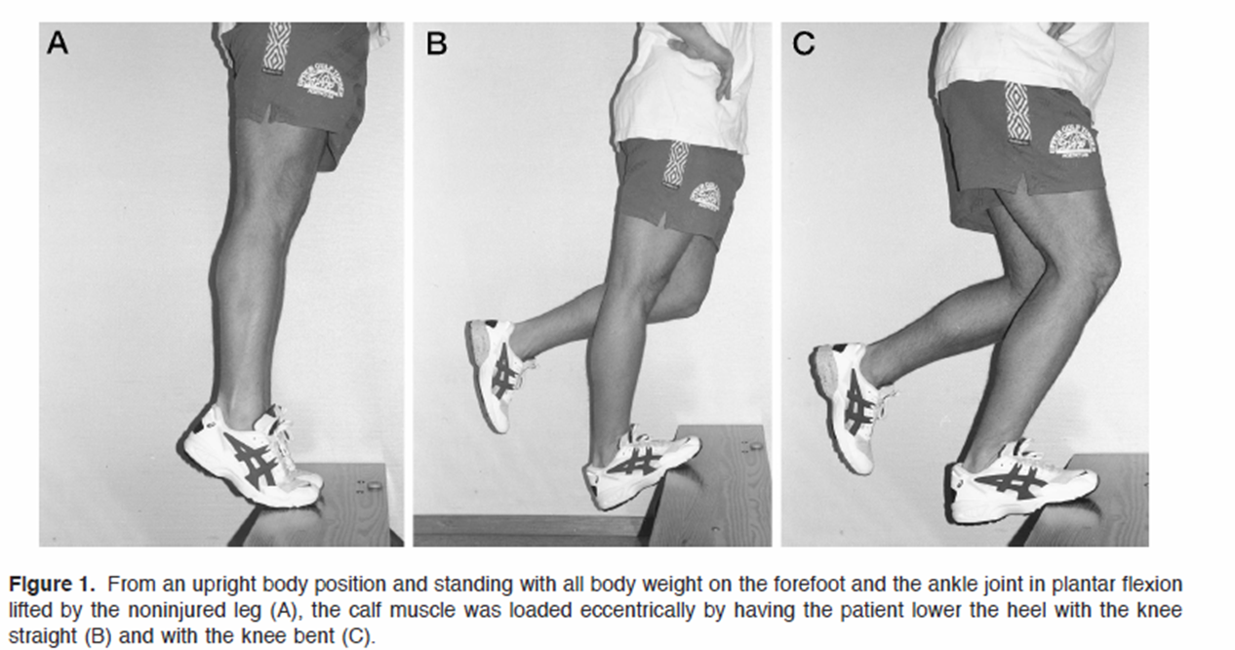
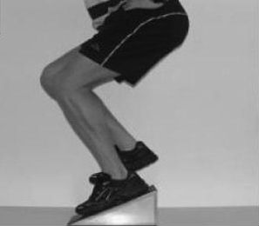
Tendonitis Treatment
Achilles Tendonitis
Patella Tendonitis

Slide 23
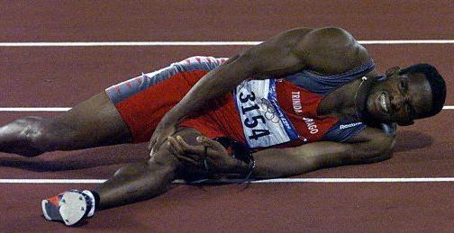
Muscle Strains
Pulling of muscle or partial tear of muscle belly usually resulting from overuse of muscle or overworking muscle
Disorder of too’s
Too much
Too fast
Too quickly
Most commonly seen in hamstring and/or calf in track athletes

Slide 24
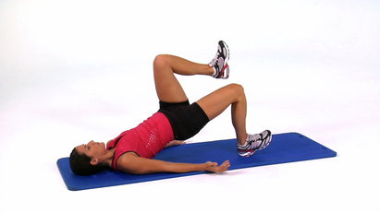
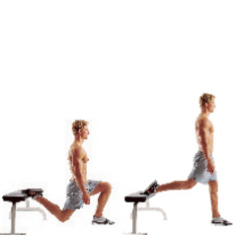
Muscle Strain Treatment
What to do:
Shorten stride length
Rest initially
Gluteus maximus strengthening
Proper footwear
Improve single leg balance
Dynamic Warm ups

Slide 25
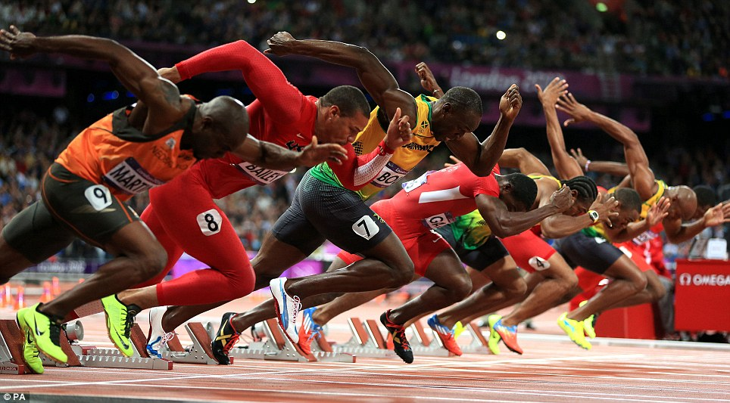
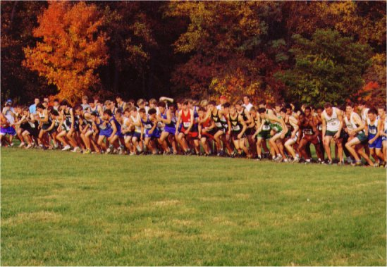
Return to Sport
Always train athlete in manner in which they will perform sport
Consider what events they participate in
Sprinters= fast twitch muscle activity with longer rest
Cross Country = slow twitch, prolonged activities
Consider break down of running mechanics
Emphasis on dynamic balance in a single leg stance
Athletes should be able to complete a full workout that mimics the
intensity and duration of their discipline prior to clearance to compete.

Slide 26
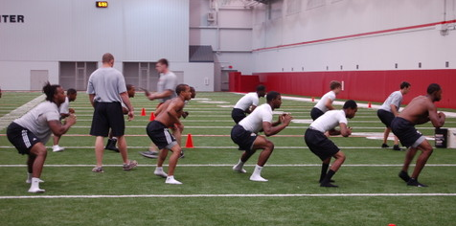
Injury Prevention
The best way to treat track and field injuries is through prevention!
Strength training program
Dynamic warm ups
Cross training
Furthermore, strength training and proper warm ups has been shown to improve running performance

Slide 27
The Research
A University of Alabama meta-analysis of the endurance training scientific literature revealed that 10 weeks of resistance training in trained distance runners improves running economy by 8-10%.
- This equates to 20-24 minutes off of a 4 hour marathon.
- Also equates to less soreness in the legs and less heavy breathing during long runs.
French researchers found that the addition of two weight-training sessions per week for 14 weeks significantly increased maximal strength and running economy while maintaining peak power in triathletes.
- Control group (only endurance training) experienced a DECREASE in peak power
- Also saw an increase in VO2max in the lifting and running group compared to the control
Chances of a running injury during 1 year of running? 66% !!
- This figure can be dramatically decreased to 20% or less with only 15-20 minutes of strength training

Slide 28
Strengthening for Track
Off Season work:
Focus on WHOLE BODY MOVEMENTS
FUNCTIONAL EXERCISES
Not just machines that isolate
Lower reps- Higher resistance
FORM, FORM, FORM
If your form is incorrect decrease the resistance
In Season:
Recommend circuit training work out to target specific muscles in the body.
Consider this your maintenance period, as well as injury prevention
Less time consuming when running higher mileages

Slide 29
Off Season Exercises
Deadlifts
Lunges
Step up with overhead press
Squats
RDL (double leg)
Planks
Chops
Lateral Walks

Slide 30
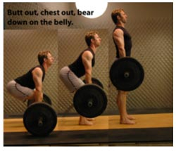
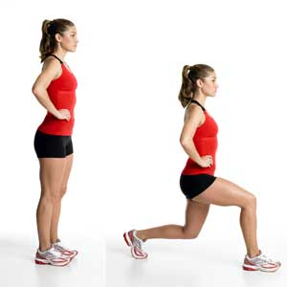
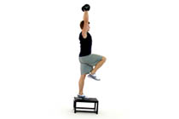
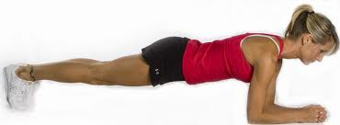
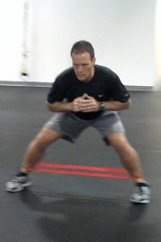
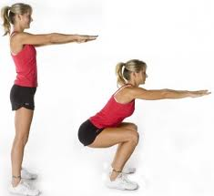
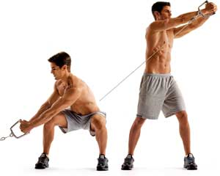
Off Season Exercises

Slide 31
Meb Keflezighi – USA (Olympian and Boston Marathon Winner
Inseason training regimen
AM: Stretch (dynamic and static)
AM: Morning run
AM: Planks, core exercise with physioball, Push-up variations
PM: Elliptigo (30 minutes)
PM: post workout stretch
PM: Run form activities: High knees, skipping, Wall pistons

Slide 32
In Season Exercises
Circuit training with:
Single leg RDL
Body weight overhead squat
Single leg bridge
Clamshell
Lateral Walk
Lunge
30 seconds to 1 minute of each exercise for 2-3 rotations through.
Rest only after finishing all 6 exercises for 1 minute
This adds a cardiovascular training element to the program

Slide 33
In Season Exercises

Slide 34
Dynamic Warm Ups
.
LEG SWINGS Swing one leg out to the side, then swing it back across your body in front of your other leg. Repeat 10 times on each side. Feel wobbly? Hold onto a steady object.
BUTT-KICKS While standing tall, walk forward with an exaggerated backswing so that your heels come up to your glutes. When this is easy, try it while jogging. Do 10 reps on each side.
HACKY-SACK Lift your left leg up, bending the knee so it points out. Try to tap the inside of your left foot with your right hand without bending forward. Repeat 10 times on each side.
TOY SOLDIER Keeping your back and knees straight, walk forward, lifting your legs straight out in front and flexing your toes. Do 10 reps on each side.
WALKING LUNGES Step forward using a long stride, keeping the front knee over or just behind your toes. Lower your body by dropping your back knee toward the ground. Maintain an upright posture and keep your abdominal muscles tight. Do 5 reps on each side.

Slide 36
Thank You!!
Mike Evangelist, MS, PT
Partner/Clinical Director
JAG Physical Therapy
West Orange
Warren
Cedar Knolls
Union
Hackensack
Woodbridge
Princeton
Fairfield
Old Bridge
New York City (40th and Madison Ave)
Please email me at mevangelist@jagpt.com for additional information
www.JAGPT.com

