Slide 1
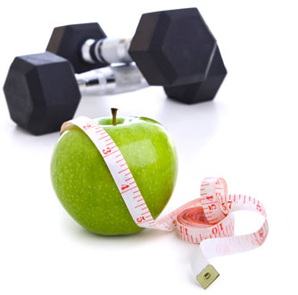
Nutrition for the Athlete

Slide 2
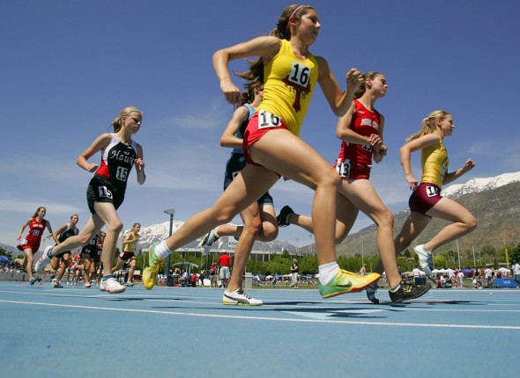
Objective
Optimizing athletic performance through proper nutrition and fueling.

Slide 3
Macronutrients

Slide 4
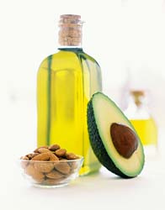
Fat
Joint lubrication
Anti-inflammatory
Hormone regulation
Vitamin A, E, D, and K absorption
Smooth muscle contractions
Essential source of energy

Slide 5
Fat
0.8 grams per kg body weight
1 gram per kg body weight
54 grams
per day
68 grams
per day

Slide 6
[

Slide 7
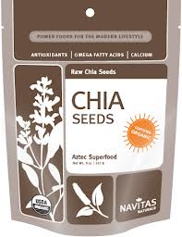
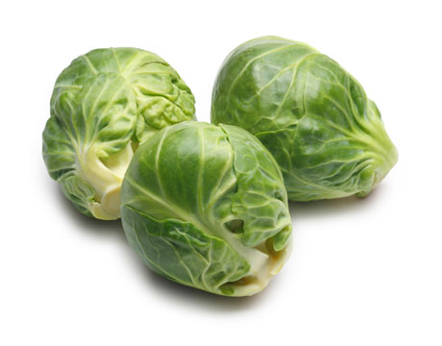
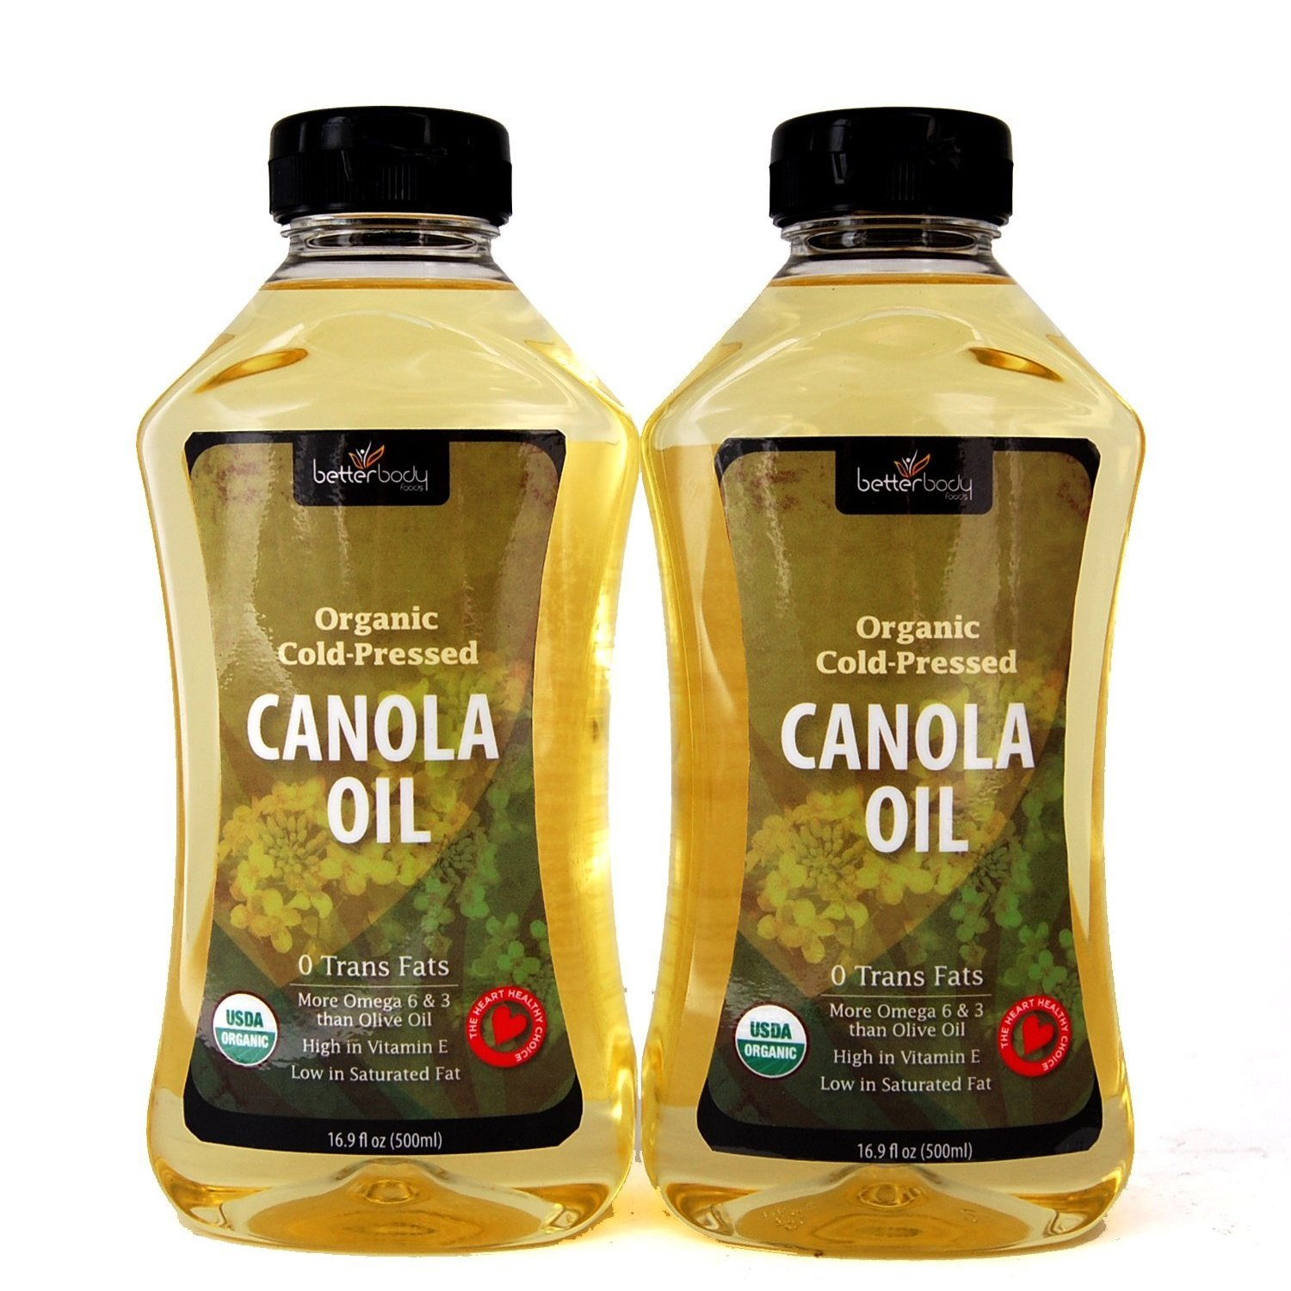
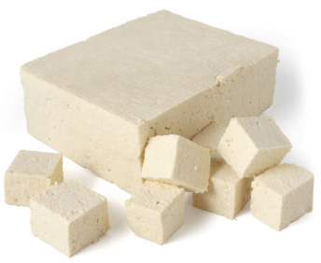
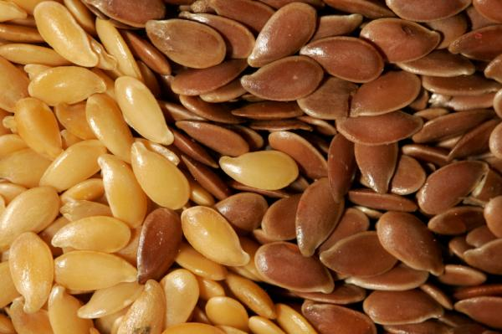
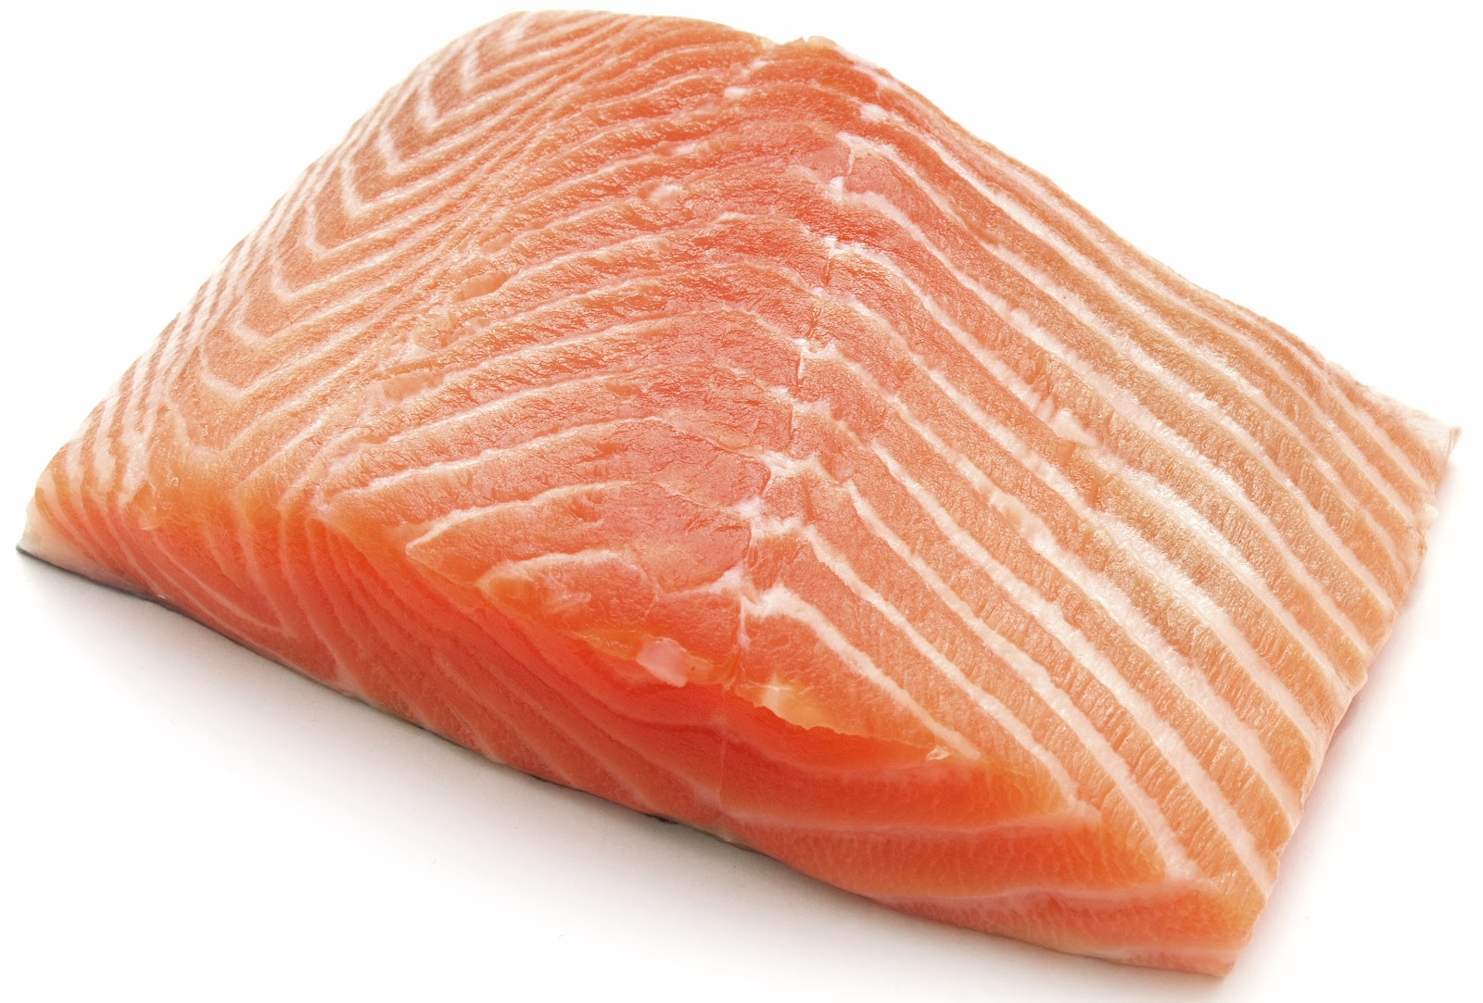
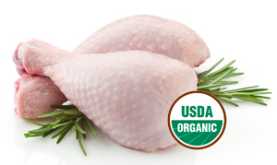
Omega-3 Sources
2.5 grams per ¼ cup
0.5 grams per 1 ½ cups
5 grams per oz
1.3 grams per tbsp
1 grams in 1 tbsp
2.5 grams in ½ cup
2 grams in 3 oz
2 grams in 3oz

Slide 8
Protein
1.2 grams protein per kg body weight
82 grams
per day
1.7 grams protein per kg body weight
116 grams
per day

Slide 9
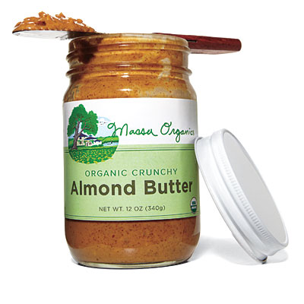
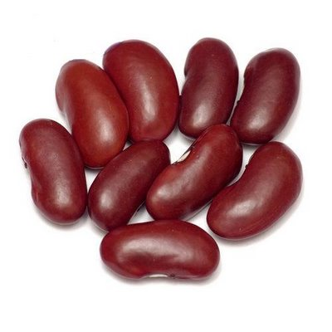
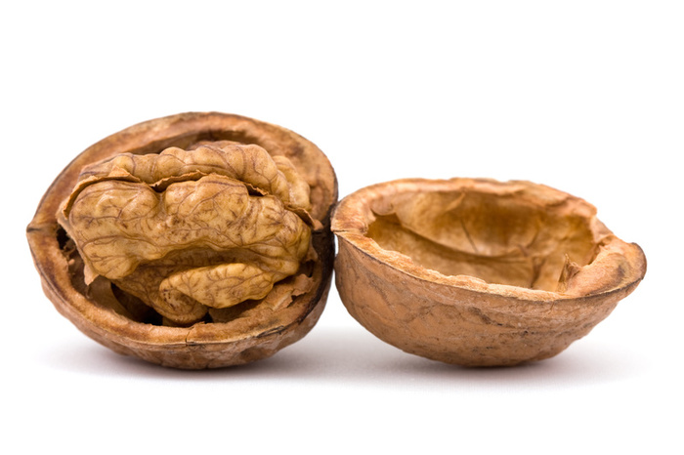
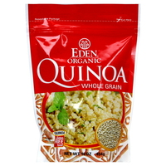
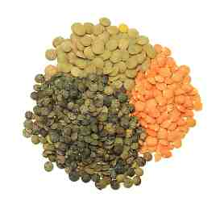
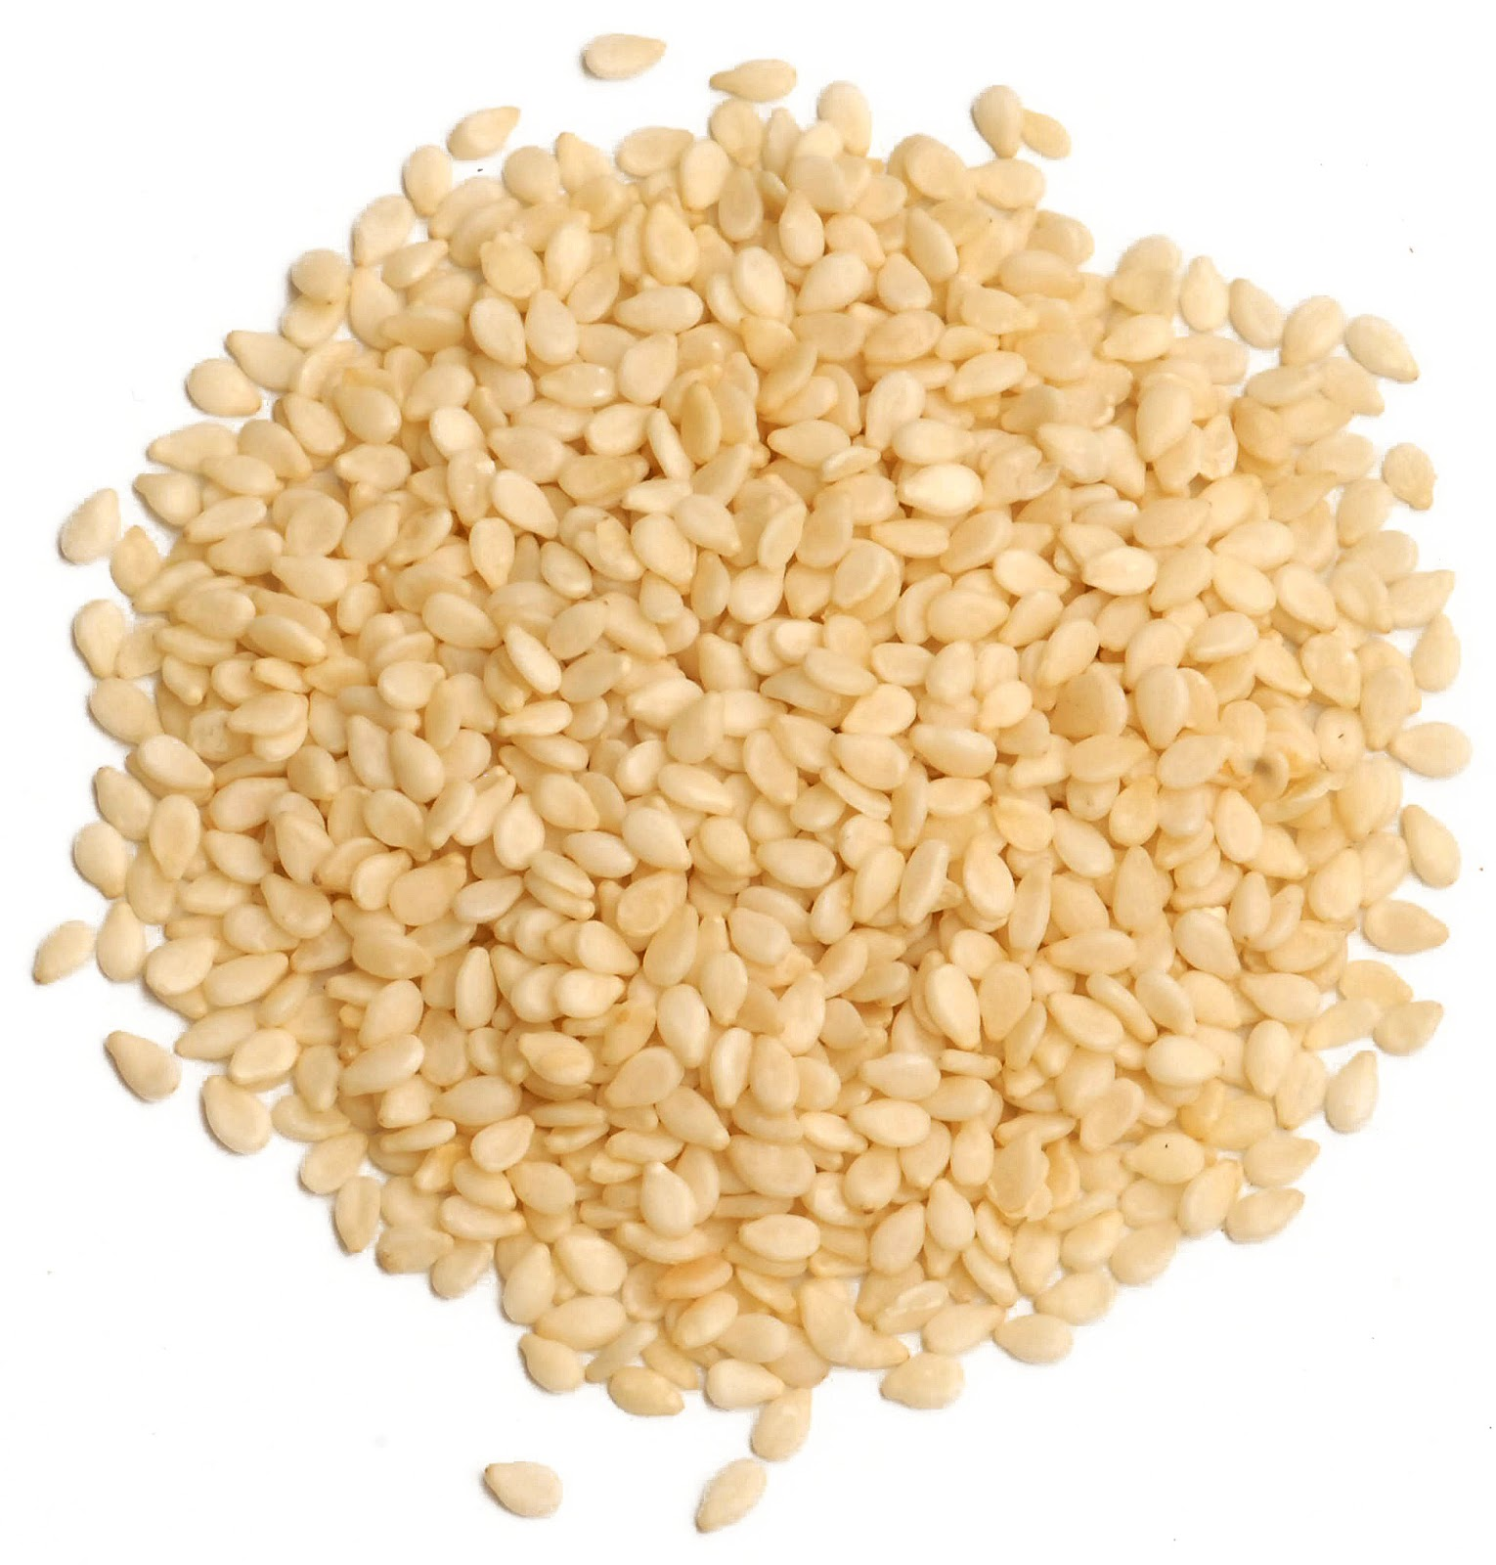
Protein Sources
15 grams in 6 oz
8 grams in ½ cup
5 grams in 1 oz
4 grams in 1 oz
8 gram in 1 cup cooked
22 grams in 1 cup
9 grams in ½ cup
6.5 grams in 1 oz

Slide 10
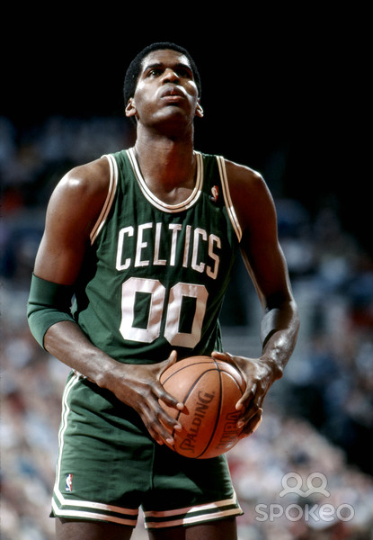
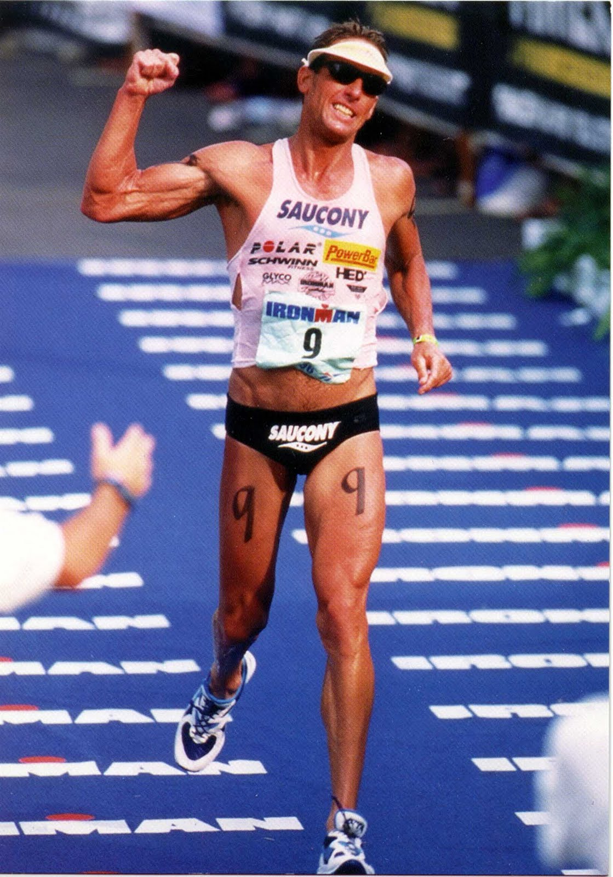
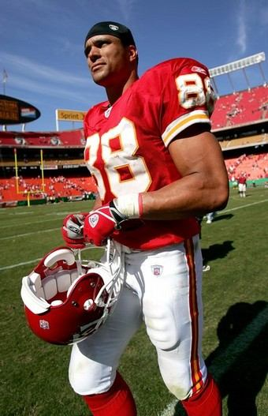
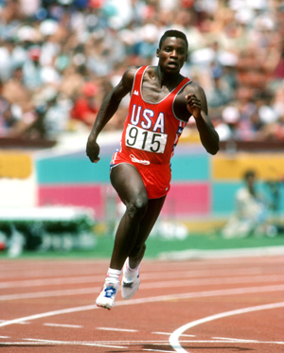
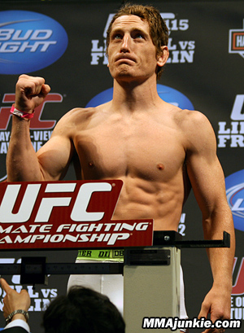
Martina Navratilova
Robert Parish
David Scott
Tony Gonzalez
Carl Lewis
Mac Danzig

Slide 11
Choosing the Right Carbohydrates

Slide 13
Protein
Fat
Carbohydrates

Slide 15
1 Cup

Slide 16
Outline of a Day
Hydration: Begin hydration at the start of your day and continue throughout
Breakfast: High protein/carbohydrate combo
Snack: High complex carbohydrate. Avoid high fat, protein, and fiber
Lunch: High protein/carbohydrate combo
2-3 hour before workout: Drink at least 500mL water
10-15 minutes before your workout: Drink at least 250mL water
During your workout: Drink 5-10 ounces every 15 minutes. Opt for a sports drink if excessive sweating occurs.
Recovery snack: Have high protein/carbohydrate salty snack within 30 minutes.
Post-Exercise Recovery Meal: Eat a 3:1 Carbohydrate : Protein ratio

Slide 17
Outline of a Day
Hydration: 500mL water to start the day
Breakfast: 2 Egg white omelet, with 1 cup assorted veggies.
1 medium banana with 1 oz raw almonds. 8oz water.
Snack: 1 slice organic whole wheat bread with 1 tbsp almond butter. Ezekiel is a great brand for bread. 1 slice should have 3 grams of fiber.
- 8oz of water.
Lunch: Salad: 3 cups of assorted veggies, 3 oz grilled organic chicken, 1oz walnuts, ½ of an avocado, 1 cups fresh berries, 1 ½ teaspoons olive oil and 1 ½ teaspoons vinegar
-Have 1 piece of whole fruit on the side.-
-Drink 500mL water.
2-3 hour before workout: Drink at least 500mL water
10-15 minutes before your workout: Drink at least 250mL water
During your workout: Drink 5-10 ounces every 15 minutes. 8oz Gatorade.
Recovery snack: 8 oz 1% chocolate milk
Post-Exercise Recovery Meal: - 3oz of salmon, 2 cups steamed vegetables, 2 cups starch (whole grain or Dreamfield’s pasta, 1 baked potato with skin, brown rice, beans).

Slide 18
Macronutrient Breakdown
Calories: 2448 calories
Protein: 117 grams (19% of your calories)
Fats: 60 grams (25% of your calories).
Carbohydrates: 345 grams (56% of your calories).
Hydration: Approximately 3 Liters

Slide 19
Breakfast Options All have at least 10 grams of protein. All take less than 3 minutes to prep.
Plain Greek Yogurt with 1 tsp cinnamon, 1 cup fresh berries.
Scrambled 2 eggs in a cup and microwave on high for 2 minutes, add ¼ cup shredded cheese on top for last 30 seconds, and put on whole grain English Muffin (1 tsp organic ketchup, optional). Apple on the side.
2 tbsp organic or natural peanut butter (can use almond or sunflower seed butter instead) on a medium banana. Can sub peanut butter for 1/2 cup almonds.
1 Van’s Organic frozen waffle toasted with 2 tbsp natural or organic peanut butter (can use almond or sunflower seed butter instead).
1 packet (or 1 cup cooked) instant Steel-cut oatmeal in water or unsweetened almond milk, with cinnamon, 1 cup berries, and ¼ cup walnuts or almonds, and ½ a banana.

Slide 20
Lunch Options All have at least 10 grams of protein. All take less than 3 minutes to prep.
Salad (spinach, arugula, or kale preferred), add 4oz grilled chicken, ½ cup beans, ¼ cup walnuts, 2 tbsp balsamic vinaigrette. Preferred vegetables to add in: tomatoes, red bell peppers, mushrooms. ¼ cup shredded cheese. Orange on the side.
Hummus avocado wrap: 1 whole grain wrap, 2 tbsp plain hummus, 1/2 avocado, cucumber, sprouts, tomato. Dip in 2 tbsp of balsamic if you’d like. 1 apple on the side.
Healthy tuna or chicken salad: mash ¼ avocado with 6oz tuna. Add any spices you like. Put on top of a salad or ½ whole grain pita. 1 cup of berries as a snack on the side.
Black bean burrito: 1 whole grain wrap, 1/2 cup black beans, ¼ avocado, ¼ small red onion, 1 teaspoon hot sauce, 2 tbsp salsa, ¼ cup cheddar cheese.

Slide 21
Carbohydrate Loading: 2 days before

Slide 22
Carbohydrate Loading: 2 days before
Hydration: 500mL water to start the day
Breakfast: 2 Egg white omelet, with 1 cup assorted vegetables.
1 medium banana, Whole grain English Muffin instead of almonds. 8 oz water
Snack: 2 slice stone ground wheat bread with 1 tbsp almond butter. Ezekiel is a great brand for bread. 1 slice should have 3 grams of fiber. 8oz of water. Doubled bread portion.
Lunch: Salad: 3 cups of assorted, 3 oz grilled chicken, 1oz walnuts, ½ of an avocado, and 2 cups fresh berries, and 1 ½ teaspoons vinegar. Eliminate olive oil to double the berries.
-Have 1 medium apple on the side.-.
-Drink 500mL water.
2-3 hour before workout: Drink at least 500mL water
10-15 minutes before your workout: Drink at least 250mL water
During your workout: Drink 5-10 ounces every 15 minutes. 8oz Gatorade.
Recovery snack: 16 oz 1% chocolate milk. Doubled portion.
Post-Exercise Recovery Meal: - 3oz of salmon, 2 cups cooked vegetables, 1 and ½ sweet potato. Or 3 cups of cooked qunioa, semolina pasta, low glycemic index complex carb choice.

Slide 23
Macronutrient Breakdown
Calories: 2384 calories
Protein: 107 grams (18% of your calories)
Fats: 31 grams (12% of your calories).
Carbohydrates: 417 grams (70% of your calories).
Hydration: Approximately 3 Liters

Slide 24
Pre-Game Fueling
Have a meal 3 hours before.
Avoid eating too much fiber (have whole wheat instead of stone ground). Keep carb choices 3 grams of fiber and under.
Do not overload on protein (keep it to 4oz or less).
Nothing greasy, fried, or high-fat.
Foods high in B vitamins and electrolytes are good.
Make sure you are well hydrated all day.

Slide 25
Pre-game Fueling: Meal Examples
Peanut butter and banana sandwich on whole wheat bread.
Turkey (Boarshead or Applegate are good choices) sandwich on whole wheat with lettuce, tomato, mustard, and an apple one the side.
Greek yogurt parfait: 6oz plain Greek yogurt, with 1 cup of fresh berries, and ½ cup low-sugar Granola (less then 10 grams per serving. Bare Naked and Cascadian Farms are good brands). *1 tsp cinnamon.

Slide 26
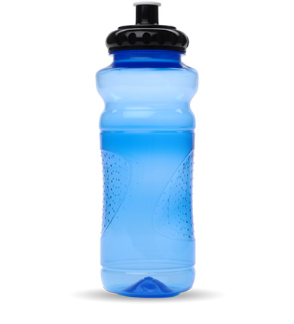
Pre-game Fueling: Proper Hydration
2-3 hour before workout: Drink at least 500mL water
10-15 minutes before your workout: Drink at least 250mL water

Slide 28
During Your Game or Event!
During your workout: Drink 5-10 ounces every 15 minutes. 8oz Gatorade with excessive sweating.
If working out more than 90 minutes, experiment with carbohydrate replacements at ~45-60 minutes in, and prior to the event or game.

Slide 29
Recovery
“Consuming an adequate amount of carbohydrates in the 20 to 30 minutes after a workout restores your muscles' energy stores, while an adequate amount of protein assists in recovery and repair. If you wait just two hours post workout to consume a meal, your ability to refuel your muscles diminishes by 50 percent”.
Journal of Applied Physiology, 2002

Slide 30
Recovery
American Journal of Clinical Nutrition, pinpointed 20 grams as the best amount of post-workout protein to maximize muscle growth.
60 grams of carb for every 20 grams of protein.
Too much protein and your body will store what it can't immediately use.

Slide 31
Recovery
Winter Smoothie
Ingredients
1/2 bunch kale
2 small beets
1 carrot
1 apple
1/4 peeled grapefruit
6oz cup plain Greek yogurt
Directions
In a fruit and vegetable juicer, juice all ingredients except into a tall glass. Add a dash of cayenne powder or hot sauce to the juice; serve immediately. If you are using a blender instead of a juicer be sure to peel the skins off first.
Nutrition: Calories: 290 per serving Fiber: 8 grams. 5 grams without apple peel. Protein: 20 grams

Slide 32
Recovery
Apple Pie Smoothie
Ingredients:
1 cups unsweetened organic applesauce
1 cup unsweetened almond milk
1 teaspoon natural vanilla extract
½ teaspoon ground cinnamon
very thin slice of fresh ginger
pinch of nutmeg
pinch of sea salt
2 tablespoons chia seeds
1 scoop protein powder
Directions
Blend all ingredients until smooth; add ice if desired.
Nutrition: 225 calories, 8 grams fiber, and 20 grams protein.

Slide 33
Recovery
Berry-Peach-Carrot Smoothie
1 medium carrot (peeled)
1 cup rapberries
1 fresh peach
6 or frozen strawberries
6 oz plain Greek yogurt
1 tsp chia seed
Blend until somewhat runny (the frozen strawberries make this more like a frozen yogurt when first combined, needs a little more blending to make it drinkable).
Nutrition: Calories: 236 per serving, Fiber: 6 grams Protein: 21 grams

Slide 34
Nutrition for the Athlete

